Slide 1
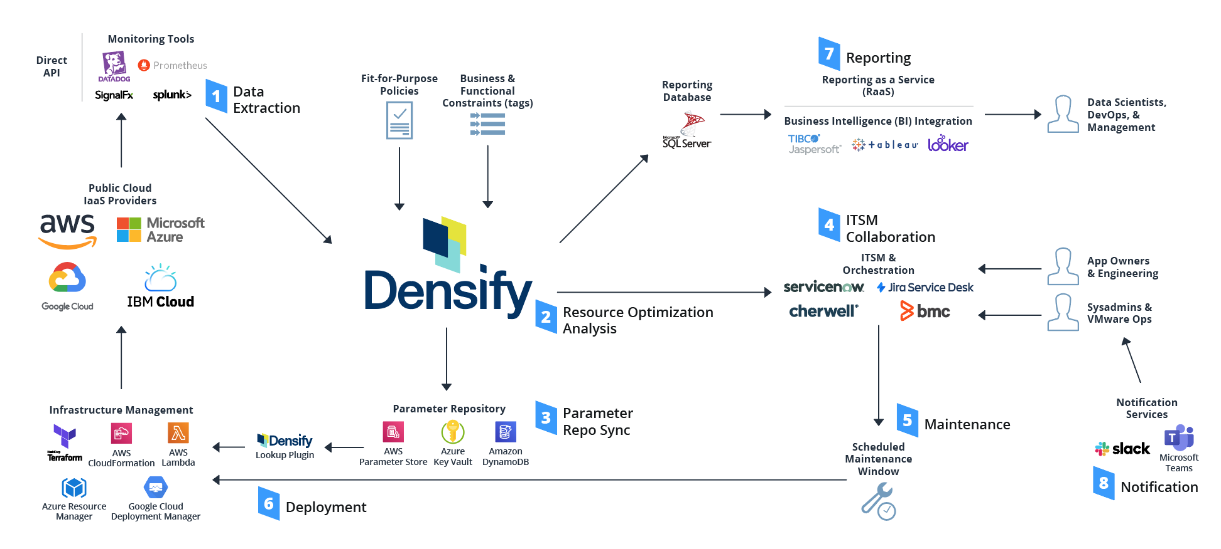
General Reference Architecture

Slide 2






Solution Architecture ITSM Collaboration
ServiceNow
Adapter
AWS Ops Center
Collaboration
Orchestrator
API Gateway
Work Dispatcher
Process
Insights
Parameter
Store
CloudWatch

Slide 3


Solution Architecture Maintenance Window Scheduling
AWS Ops Center
ScheduleMaintenanceWindow
Automation
Doc
Maintenance
Window
Parameter
Store

Slide 4



Solution Architecture Execution
ServiceNow
Adapter
AWS Ops Center
Maintenance
Window
Collaboration
Orchestrator
Executor-S1
Executor-S2
CloudWatch
SNS
CloudFormation
API Gateway
API
Support
Parameter
Store
Insight
Lookup Function

